Slide 1
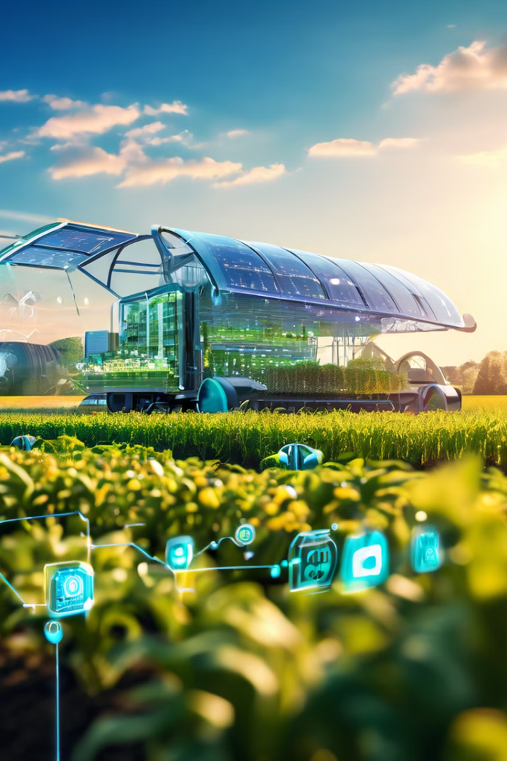
The AI and IoT-Based Crop Recommendation System
The AI and IoT-based crop recommendation system uses real-time sensor data to predict suitable crops. A machine learning model trained on features like nitrogen, phosphorus, potassium, rainfall, humidity, temperature and pH. Sensor data is collected over half a day, averaged, and fed to the ML model. The web app, built with HTML, CSS, and Flask, enables: Real-time sensor data transmission via Wi-Fi. Data storage in CSV files with a time index.

Slide 2
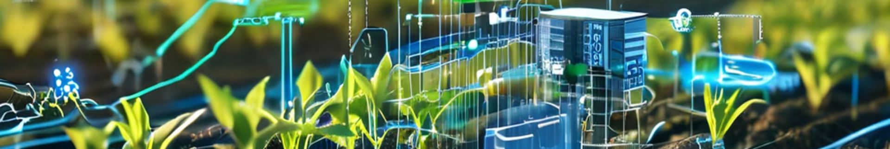
Abstract and Objective of the Project
Project Abstract
Machine Learning Model
The AI and IoT-based crop recommendation system utilizes real-time sensor data to predict suitable crops for cultivation.
A machine learning model is trained on features including nitrogen, phosphorus, potassium, rainfall, humidity, temperature and pH.
Data Collection
Web Application
Sensor data is collected over half a day, averaged, and then fed into the machine learning model for analysis.
The system includes a web app built with HTML, CSS, and Flask, enabling real-time sensor data transmission and storage.

Slide 3
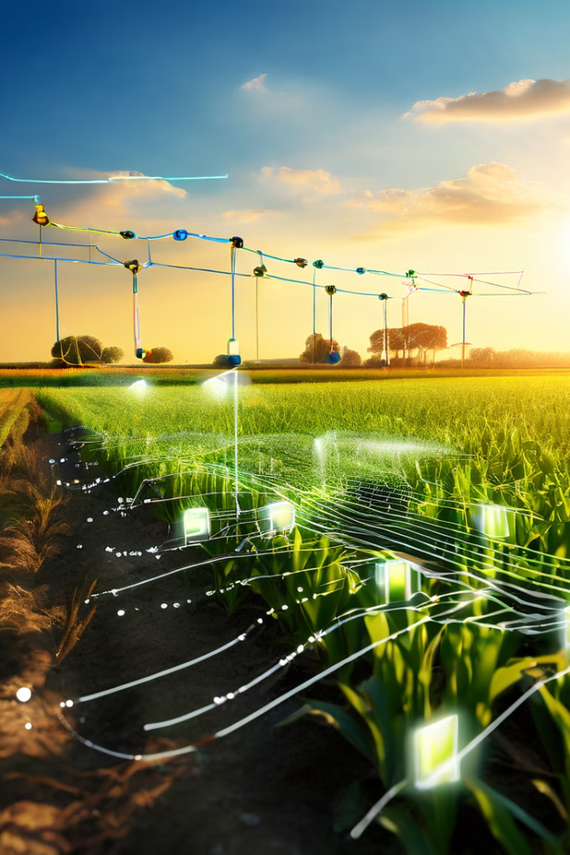
Real-time sensor data collection and Transmission
1
Sensor Deployment
IoT sensors are placed in the agricultural field to collect real-time data on various parameters.
2
Data Collection
Sensors gather data on nitrogen, phosphorus, potassium, rainfall, humidity, temperature and pH over a half-day period.
3
Data Averaging
The collected sensor data is averaged to provide a comprehensive snapshot of field conditions.
4
Wi-Fi Transmission
The averaged data is transmitted in real-time via Wi-Fi to the web application for further processing.

Slide 4

Data storage in CSV files with a time index for Future analysis
Time Index
Nitrogen
Phosphorus
Potassium
Rainfall
Humidity
Temperature
pH
2023-05-01 09:00
45
30
25
150
65
28
6.5
2023-05-01 15:00
48
32
27
0
60
30
6.7

Slide 5
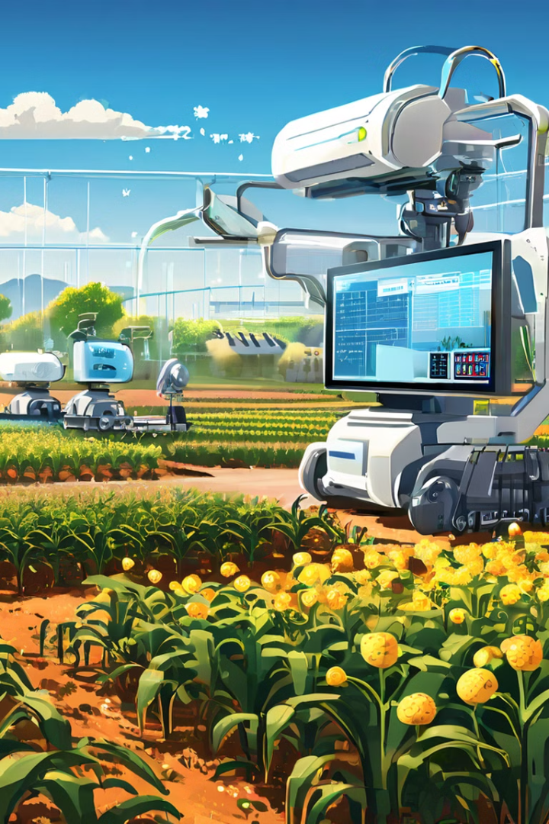




Machine learning model development and training
Data Preparation
Collected sensor data is preprocessed and formatted for use in machine learning.
Model Selection
An appropriate machine learning algorithm is chosen for crop recommendation based on the available features.
Model Training
The selected model is trained using historical data on crop performance and environmental conditions.
Model Evaluation
The trained model is evaluated using test data to assess its accuracy in crop recommendations.

Slide 6
Web application design and implementation
Frontend Development
Backend Development
Integration
The web application's user interface is designed using HTML and CSS to provide an intuitive experience for farmers.
Flask is used to create the backend of the web application, handling data processing and communication with the machine learning model.
The frontend and backend are integrated to create a seamless web application that displays real-time sensor data and crop recommendations.

Slide 7
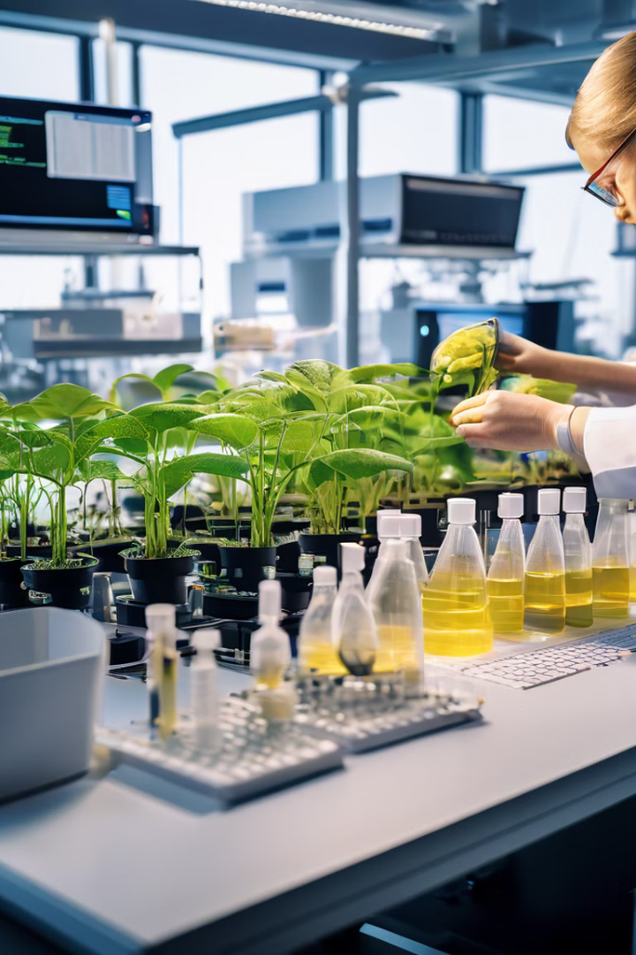
Technology readiness level : proof of concept phase with working prototypes
1
TRL 3: Proof of Concept
2
Working Prototypes
The AI and IoT-based crop recommendation system is currently at Technology Readiness Level 3, indicating it is in the proof of concept phase.
Functional prototypes of the system have been developed and are being tested in controlled environments.
3
Ongoing Development
The project team continues to refine and improve the system based on initial testing results and feedback.

Slide 8
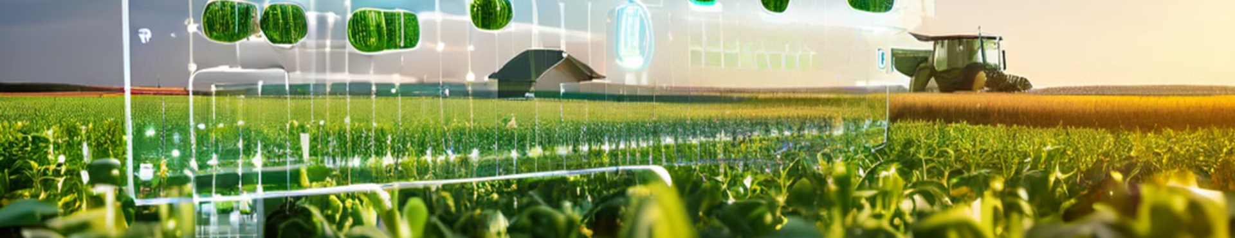




Uniqueness of the Project
Real-time Data
AI-powered
Cloud Storage
Accessible
Utilizes up-to-the-minute sensor data for accurate crop recommendations.
Leverages machine learning for intelligent crop selection based on multiple factors.
Stores data in CSV format with time indexing for future analysis and improvements.
Web-based application allows easy access for farmers from various devices.

Slide 9
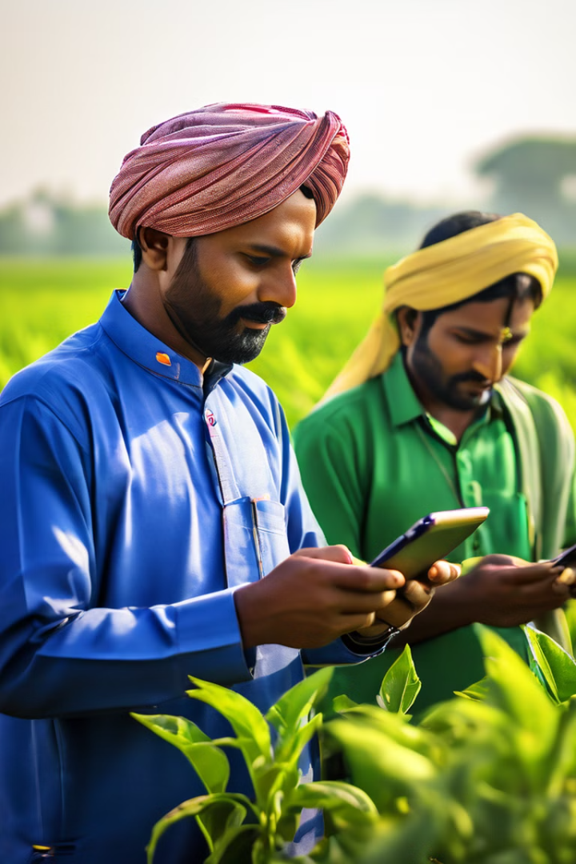
Establishment in Indian Market
1
Market Research
Conduct thorough analysis of Indian agricultural sector and farmer needs.
2
Localization
Adapt the system to local crop varieties, climate conditions, and farming practices.
3
Partnerships
Collaborate with local agricultural institutions and farmer cooperatives for wider adoption.
4
Scaling
Gradually expand the system's reach across different regions of India.

Slide 10
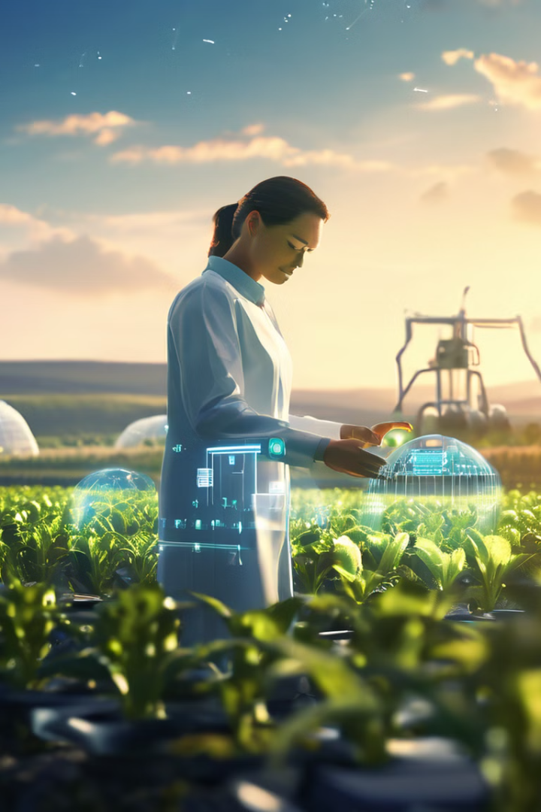
Conclusion and Future enhancement with a Chatbot
Project Conclusion
Current Status
The AI and IoT-based crop recommendation system shows promise in revolutionizing agricultural decision-making.
At TRL 3, the system has demonstrated its potential through working prototypes and proof of concept.
Future Enhancement
Continuous Improvement
Plans to integrate a chatbot to provide interactive guidance and support to farmers using the system.
Ongoing refinement of the machine learning model and user interface based on real-world usage and feedback.

